Slide 1
Instrumentation and Product Testing
Ninth Lecture
Analog-to-Digital Converter (ADC)
And
Digital-to-Analog Converter (DAC)

Slide 2
1. DAC
In an electronic circuit, a combination of high voltage (+5V) and low voltage (0V) is usually used to represent a binary number. For example, a binary number 1010 is represented by
Weighting
2³
2²
2¹
2⁰
Binary Digit
1
0
1
0
State
+5V
0V
+5V
0V
DACs are electronic circuits that convert digital, (usually binary) signals (for example, 1000100) to analog electrical quantities (usually voltage) directly related to the digitally encoded input number.

Slide 3
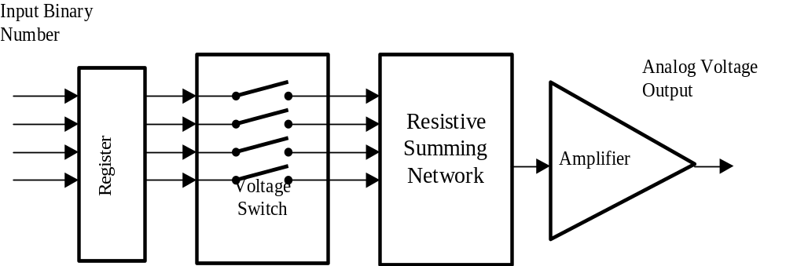
DACs are used in many other applications, such as voice synthesizers, automatic test system, and process control actuator. In addition, they allow computers to communicate with the real (analog) world.

Slide 4
Register: Use to store the digital input (let it remain a constant value) during the conversion period.
Voltage: Similar to an ON/OFF switch. It is ‘closed’ when the input is ‘1’. It is ‘opened’ when the input is ‘0’.
Resistive Summing Network: Summation of the voltages according to different weighting.
Amplifier: Amplification of the analog according to a pre-determined output voltage range. For example, an operation amplifier

Slide 5
The two most popular types of resistive summing networks are:
• Weighted binary resistance type, and
• Ladder resistance (R-2R) type

Slide 6
2. ADC
Numerous methods are used for converting analog signals to digital form. Five most commonly used methods are listed below:
Staircase ramp
Successive approximation
Dual slope
Voltage to frequency
Parallel (or flash)

Slide 7
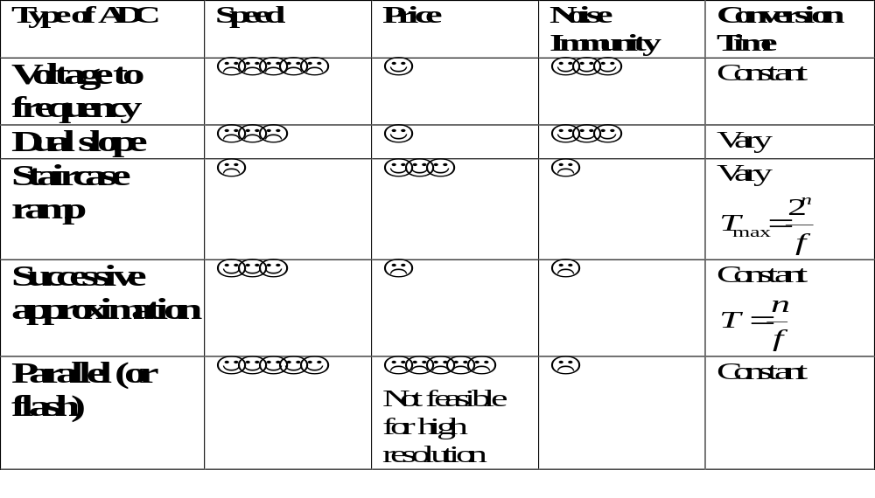

Slide 8
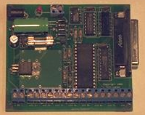
In practice, an ADC is usually in form of an integrated circuit (IC). ADC0808 and ADC0809 are two typical examples of 8-bit ADC with 8-channel multiplexer using successive approximation method for its conversion.
ADC0809
National Semiconductor
For more information,
http://www.national.com/ads-cgi/viewer.pl/ds/AD/ADC0808.pdf

Slide 9
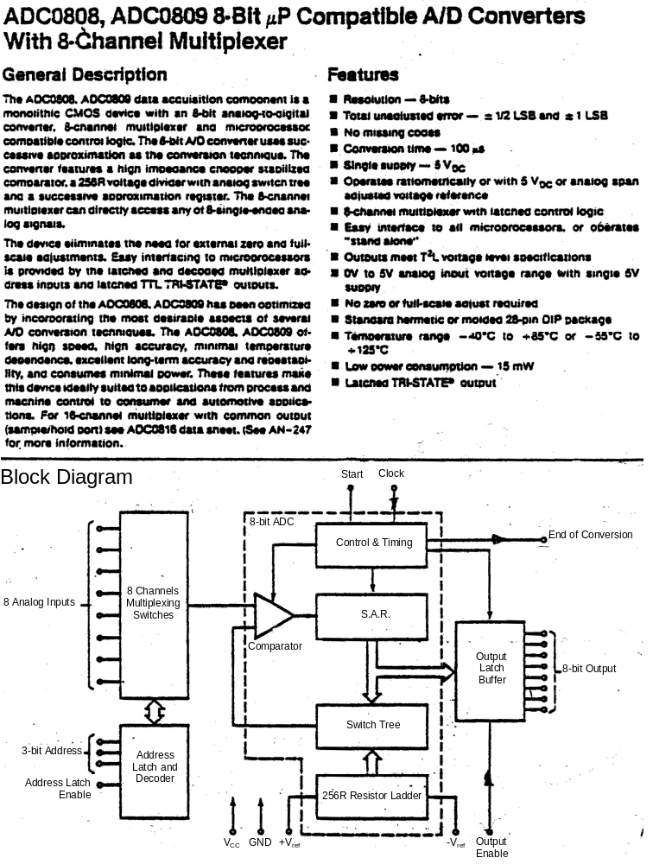

Slide 10
When this ADC is connected to a computer, the sequence of operation is listed below:
1. The computer reads the EOC to check the ADC is busy or not.
2. If the ADC is not busy when the computer selects the input channel and send out the “Start” signal. Otherwise, step (1) is repeated.
3. The computer monitors the EOC.
4. When the EOC is activated, the computer reads the digital output.
When there is more than one ADCs being linked to the computer, they can be connected in parallel. Using the ‘output enable’ can do the selection of ADC output.

Slide 11
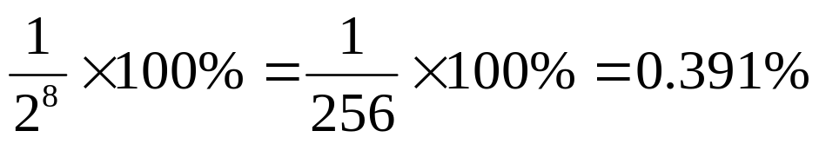
3. Selection of DAC
For the selection of an IC DAC, there are several parameters that can determine the suitability of a particular device.
Resolution
The number of bits making up the input data word that will ultimately determine the output step voltage as a percentage of full-scale output voltage.
Example: Calculate the resolution of an 8-bit DAC.
Solution: Resolution = 8 bits
Percentage resolution =

Slide 12
Output Voltage Range
This is the difference between the maximum and minimum output voltages expressed in volts.
Example:
Calculate the output voltage range of a 4-bit DAC if the output voltage is +4.5V for an input of 0000 and +7.5V for an input of 1111.
Solution:
Output voltage range = 7.5 – 4.5 = 3.0V

Slide 13
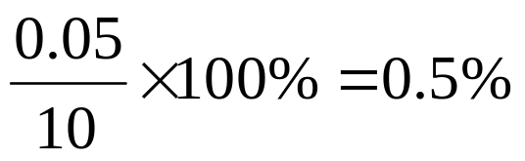
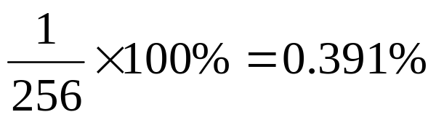
Accuracy
The accuracy is usually expressed by the error in output voltage compared with the expected output voltage. The higher the accuracy, the lower will be the error. Due to the incremental nature of the digital input word, an error can be tolerated but it should not exceed ±½LSB or ½resolution.
Example. The error at full-scale for an 8-bit DAC with 10V maximum output is 50mV. Calculate the error and compare it with the resolution.
Solution: Error =
Resolution = ; ½ Resolution = 0.195%

Slide 14
The accuracy is not as good as the error = ½ resolution, but for many applications, it is quite satisfactory. Some commercially available DACs have their accuracy specified as worse than ½ resolution.
Sources of errors may be broadly classified under four categories:
• Non-monotonicity
• Non-linearity
• Scale-factor error
• Offset error

Slide 15
Settling time
The time taken for the applied digital input to be converted to an analog output. Typical period can be as low as 100ns, making DA conversion a very fast process compared with those of AD conversion.
Input coding
The digital input can be in binary format or it can be in binary coded decimal format depending on the application. Binary format is more commonly used.

Slide 16
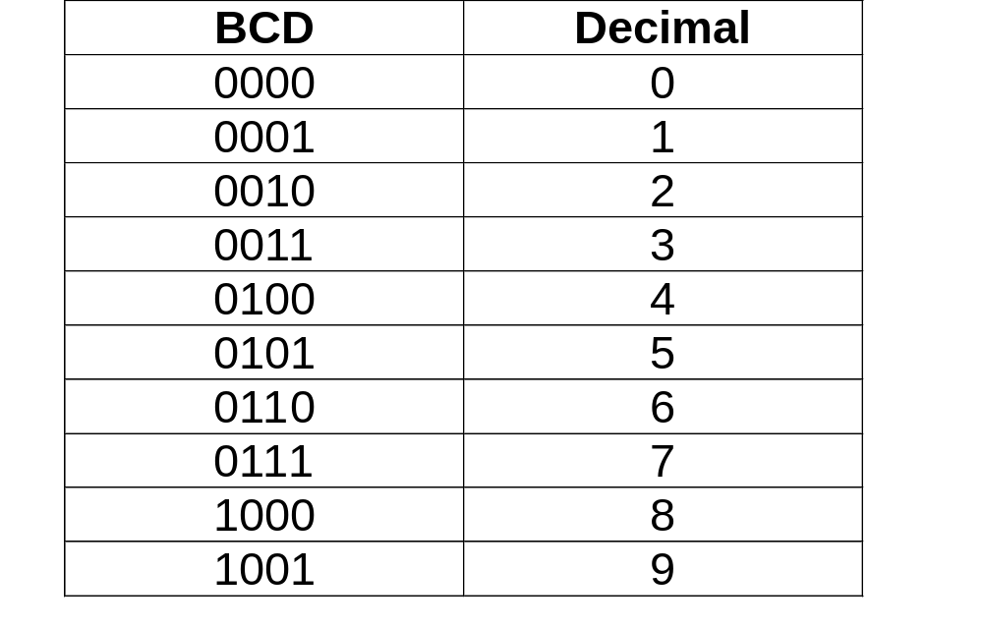
Binary-coded decimal, or BCD, is a method of using binary digits to represent the decimal digits 0 through 9. A decimal digit is represented by four binary digits, as shown below:

Slide 17
It should be noted in the table above that the BCD coding is the binary equivalent of the decimal digit. However, BCD and binary are not the same.
For example,
49₁₀ in binary is 110001₂,
but
49₁₀ in BCD is 01001001_{BCD}.
Each decimal digit is converted to its binary equivalent.

Slide 18
4. Selection of ADC
The parameters used in selecting an ADC are very similar to those considered for a DAC selection.
Error/Accuracy: Quantising error represents the difference between an actual analog value and its digital representation. Ideally, the quantising error should not be greater than ± ½ LSB.
Resolution: ΔV to cause 1 bit change in output
Output Voltage Range ⇒ Input Voltage Range
Output Settling Time ⇒ Conversion Time
Output Coding (usually binary)

Slide 19
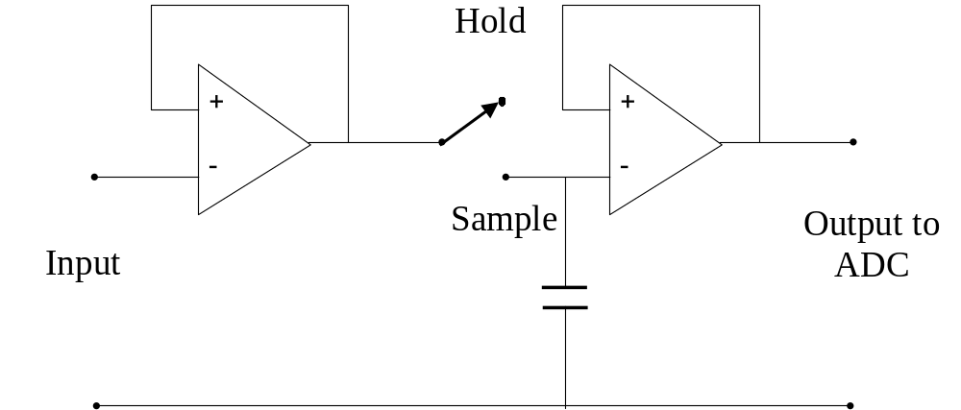
To measure an AC voltage at a particular instant in time, it is necessary to sample the waveform with a ‘sample and hold’ (S/H) circuit.

Slide 20
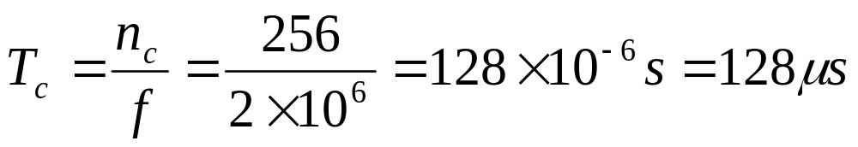
5. Worked Examples
Question 1. Calculate the maximum conversion time of (a) a 8-bit staircase ramp ADC and (b) a successive approximation ADC, if the clock rate is 2MHz.
Solution:
(a) For a 8-bit staircase ramp ADC, the maximum number of count is
n_{c} = 28 = 256
Therefore, the maximum conversion time is

Slide 21
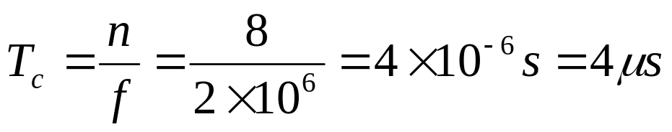
(b) For a 8-bit successive approximation ADC, the conversion time is constant and equal to
It can be noted that the conversion speed of successive approximation ADC is much faster than the staircase ramp type.

Slide 22
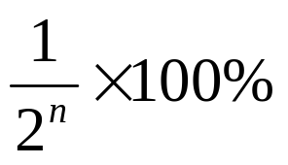
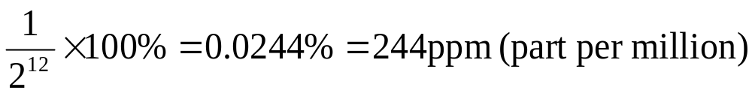
Question 2.
Find out the percentage resolution of a DAC of n bits, and hence determine the value for n = 12.
Solution:
Percentage resolution =
For n = 12,
Percentage resolution =

Slide 23
Thank you

